Slide 1
Object-Oriented System Development
Django Best Practices & E2E Testing
Semester 1, 2019

Slide 2
OOSD going forward
Labs and assignment
This is the last week of content
Django best practices/design patterns
E2E testing
Anti-patterns

Slide 3
Django best practices/design patterns
Templates
Views – do we use class based or function based
Workflow
Pep-8
Static analysis
Python virtual environment
Notes:
Up to now, you have talked about design patterns (creational, structural, behavioral and concurrency) – typical solutions to common problems
Each pattern is like a blueprint that you can customise to solve a particular design problem in your code
In the Django community, there are a collection of common design patterns. The design patterns that I talked about aren’t design patterns in terms of Gang of Four
Calling them design patterns is just a convenient for the community
`You should have at least base.html file either at the project level or app level
Use generic/class based views instead of function based views. It will reduce repetitive code in your views. View include:
Detail
List view – this will be useful for your assignment
Editing view – CRUD functionaility
Following standards/conventions such as Pep8 – the standard for Python
Created in 2001 by Guido Van Rossum, Barry Warsaw and Nick Coghlan
Focuses on readability and consistency of Python code
Remember that will we be reading code more often than writing code
Used static analyzers/linters to adhere to Pep8 standards. Don’t rely on manually testing your application to see if it works
There are linters for various languages such as JS, Python and Ruby. There is usually an extension in your code editor for this

Slide 4
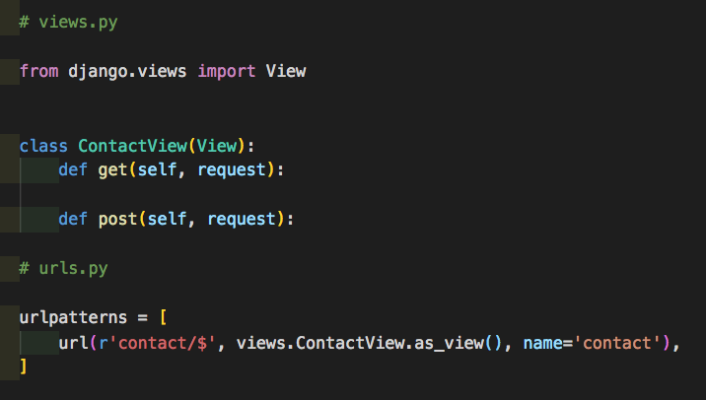
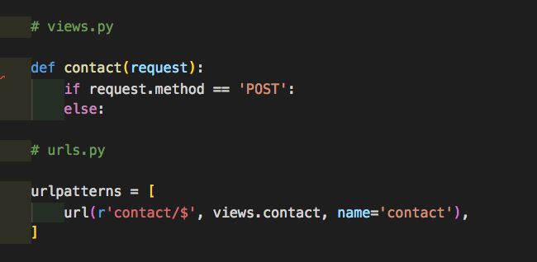
Views – class based vs function based
Notes:
In the class based example, a dispatch method will trigger and handle the HTTP logic (GET, POST, PUT, DELETE)
If your request in POST, it will execute the post method inside the view
Function based views are handled usually with if statements

Slide 5
Python virtual environment
What is Python virtual environment?
Why is a Python virtual environment needed?
Setting up a Python virtual environment with Pipenv
You no longer need to use pip and virtualenv separately
Using and managing requirements.txt can be a problem
Exposes security vulnerabilities
Notes:
Virtual environment create isolation for your Python projects whether it is a script, Flask or Django project
Each project has its own dependencies
You can now use pip and virtualenv separately with pipenv
Pipenv uses Pipfile and Pipfile.lock to separate dependency declarations
Hashes are used in Pipfile.lock for security automatically exposing security vulnerabilities in your project
Encourages up to date dependencies

Slide 6
What is test automation?
A process of writing a program to do testing that would otherwise need to be done manually
Use of software to control the execution of tests
Code-driven testing
Graphical user interface testing
Notes:
Software includes:
CircleCI
Jenkins
TravisCI
Code driven testing:
TDD
BDD

Slide 7
E2E testing
What is E2E testing?
Why is E2E testing important?
Reliable
Repeatable
Reusable
Better quality software
Speed
Cost reduction
Notes:
E2E is also called UI or browser testing
Tests whether the flow of an application is performing as designed from start to finish
Simulates a real world scenario and validates a system or systems for integration and data integrity
Tests perform the same operation each time they are run
Tests how the software reacts under repeated execution
Tests run on different versions of the software
Rapid feedback to the developer
Runs faster than humans and less error prone
The number of regression tests are reduced
Regression testing – confirms that a program change has not affected existing features

Slide 8
A real-world scenario we could test end-to-end
Email application (Gmail, Outlook, etc)
Notes:
For example, a simplified end-to-end testing of an email application might involve:
Logging in to the application
Accessing the inbox
Opening and closing the mailbox
Composing, forwarding or replying to email
Checking the sent items
Logging out of the application

Slide 9
Selenium WebDriver
A collection of open source APIs
Supports many browsers
Automate web applications only
Supports different languages
Platform-independent
Different location strategies
Notes:
A web automation framework that allows you to execute your tests against different browsers
Collection of open source APIs and drivers
Programming languages supported include C#, Java, JavaScript, Perl, PHP and Ruby
Currently, Selenium WebDriver only automates web-based applications. It doesn’t support window-based application
Can run on various operating systems such as Windows, Linux and MacOS
Local strategies include class name, CSS selector and XPath

Slide 10
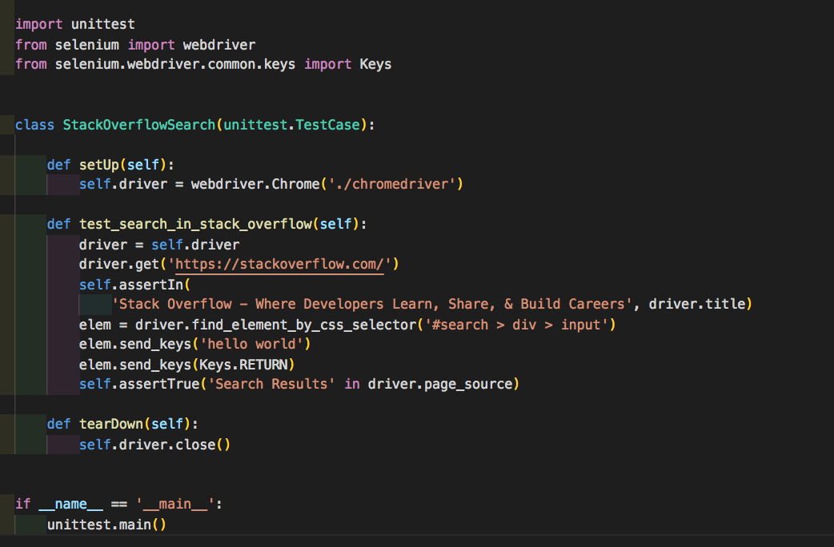
Code example

